Slide 1
Data Mining Introduction
Ehsan Mirzaei
Jun 2022

Slide 2
List of content
Data Mining introduction
Introduction and data mining definition
Data Science vs Data Mining vs BI
Data Mining Tasks
Python (Introduction and Built in function )
Data Understanding and data mining methodology
Data Understanding & Data type
Data mining methodology
Python (Pandas, Numpy)
Data per – processing
Data import / integration
Data cleaning
Missing data
Data transformation
Dimension Reduction
Python (Sklearn, Matplotlib)
Cluster Analysis
Hierarchical Clustering
KMeans
Association Rule

Slide 3
List of content
Linear and Logistic regression
Bayesian learning systems and Instance-based learning and classification.
Regression and classification trees
Neural networks and Ensemble classifiers

Slide 4
Refrence
Dean Abbott (2014) “Applied Predictive Analytics: Principles and Techniques for the Professional Data Analyst”, Wiley
Daniel T. Larose, Chantal D. Larose (2015) “Data Mining and Predictive Analytics”, 2nd Edition, Wiley
Mitchell, T., (1997) “Machine Learning”, McGraw Hill.
Hand, D. J., Mannila, H., Smyth, P. (2001) “Principles of Data Mining (Adaptive Computation and Machine Learning)”, MIT Press.
Collica, R. (2011), “Customer Segmentation and Clustering Using SAS Enterprise Miner” 2nd Edition, SAS Publishing

Slide 5
Data Mining introduction
Is a rapidly evolving research area
Intersection of several disciplines like:
Statistics,
Databases,
Machine Learning,
Operations research and optimization,
Computer science, high performance and parallel computing.

Slide 6
Data Mining introduction
The popularity comes mainly from the fact that nowadays everybody has big databases.
Behind this there is the ever decrease costs of computer.
The success of database systems in becoming the backbone of most business and science activities.

Slide 7
Data Mining introduction
Will this data help my business gain advantage?
How can we use historical data to build models of underlying processes that generated such data?
Can we predict the behavior of such processes?
How can we understand the data?

Slide 8
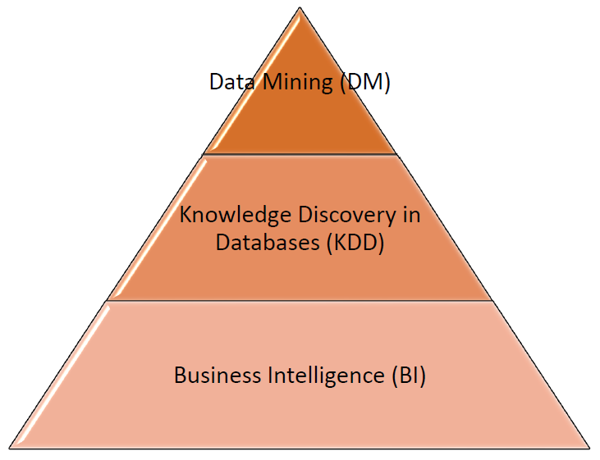
Data Science vs Data Mining vs BI
Business intelligence (BI) is a broad category of applications and technologies for gathering, storing, analyzing, and providing access to data to help enterprise users make better business decisions.
Data Science is an interdisciplinary field about processes and systems to extract knowledge or insights from data in various forms, either structured or unstructured.
Data mining is a interdisciplinary subfield of computer science to discovering patterns in large data sets involving methods at the intersection of machine learning, statistics, and database systems.

Slide 9
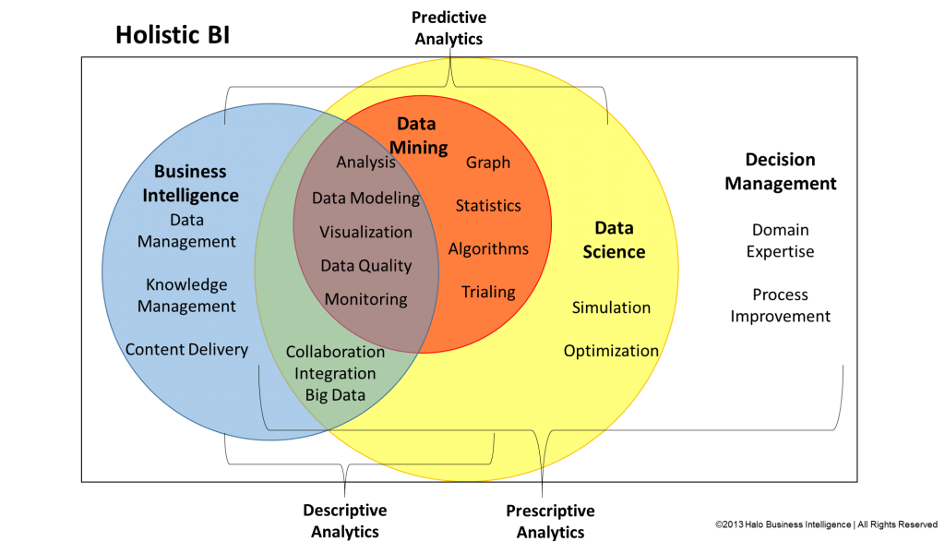
Data Science vs Data Mining vs BI

Slide 10
Data Mining Tasks
Descriptive Methods (Unsupervised Learning)
Clustering (K-means, Self-Organizing Map)
Association (Apriori Algorithm)
Predictive Methods (Supervised Learning)
Classification
Estimation

